Slide 1
Minor 2 Project
By Priti
Project Title: Metasploitable Setup and Mutillidae Configuration
Introduction
This project is based on setting up a vulnerable virtual machine called Metasploitable and configuring the Mutillidae II vulnerable web application. The main objective of this project is to understand basic system setup, user management, snapshot creation, and fixing common configuration errors in a controlled environment.

Slide 2
Objectives of the project
The main objectives of this project are:
To install and run Metasploitable successfully
To create a new user inside Metasploitable
To take a snapshot for verification
To fix Mutillidae II database error
To verify Mutillidae II working properly in browser
To gain hands-on experience with vulnerable systems

Slide 3
Metasploitable setup
                Metasploitable Installation Process
Download Metasploitable 2 ZIP file
Extract the file
Open VMware Workstation
Select Open a Virtual Machine
Choose the Metasploitable .vmx file
Start the virtual machine
Login using default credentials

Slide 4
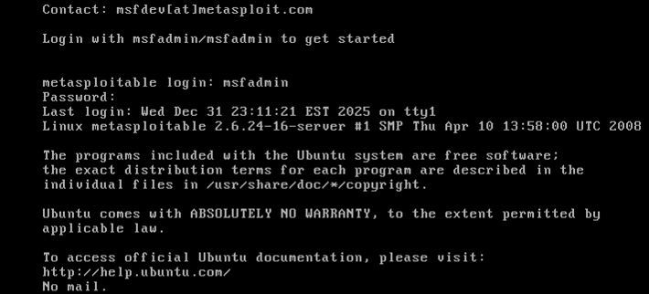
Metasploitable setup
Username: msfadmin
Password: msfadmin

Slide 5
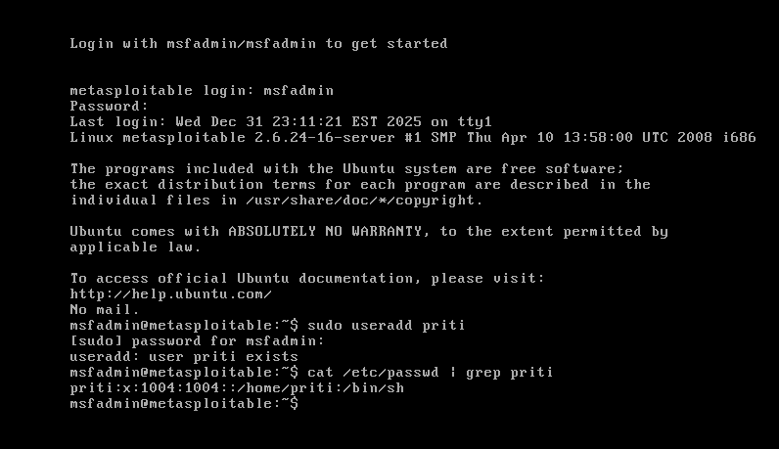
User creation in metasploitable
Create a new unser inside metasploitable
Command: sudo adduser priti
Varify user creation
Cat /etc/passwd

Slide 6
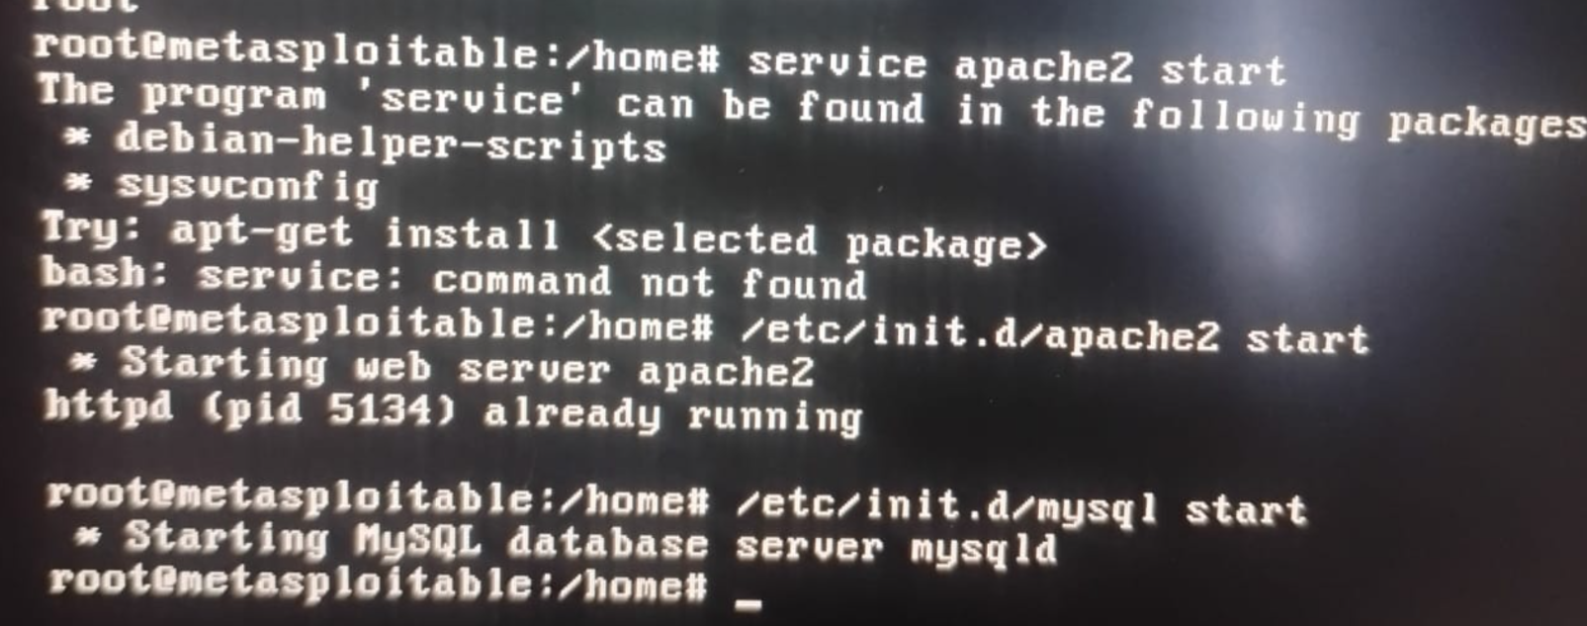
Mutillidae II Database Error Fix
Mutillidae II is a vulnerable web application used for practicing web security testing. To run Mutillidae II, Apache and MySQL services were started.
Commads used
1 sudo service apache
Start
2 sudo service mysql
start

Slide 7
After starting the required services, the IP address of the Metasploitable system was identified using the ifconfig command. This IP address was then used to access the Mutillidae II application through a web browser.
The Mutillidae II application was opened in the browser using the following URL
http://<Metasploitable-IP>/mutillidae
After this, Mutillidae II worked properly without any error.

Slide 8
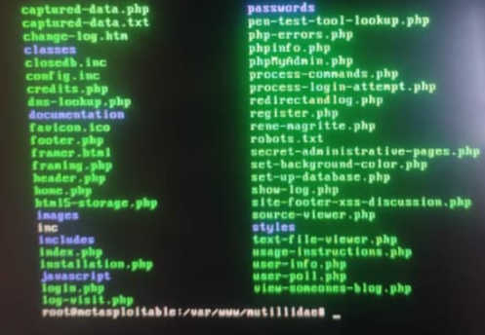

Slide 9
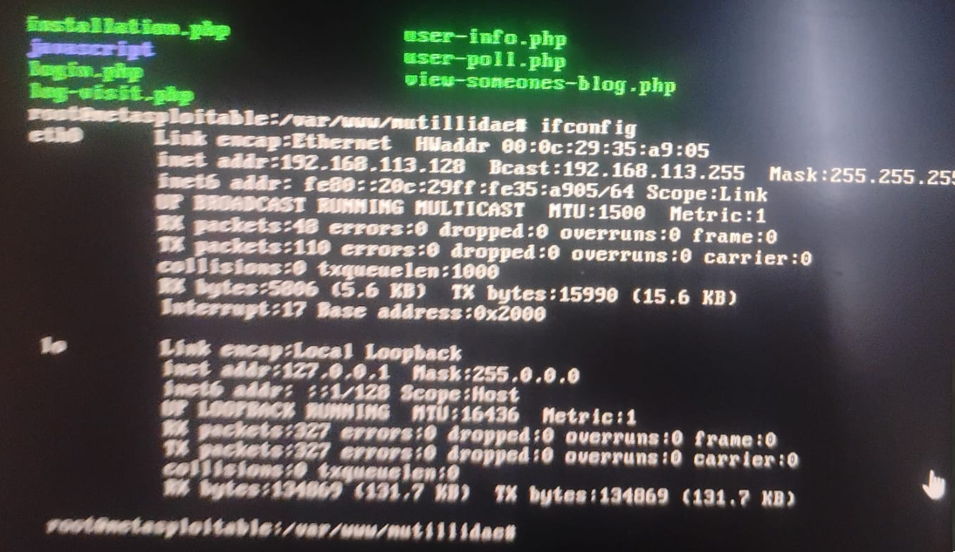

Slide 10
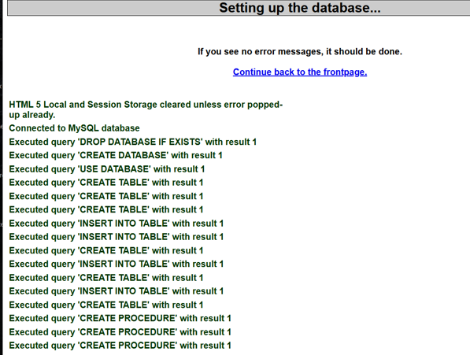
without errors.
Mutillidae II
is accessed through
browser
and verified working

Slide 11
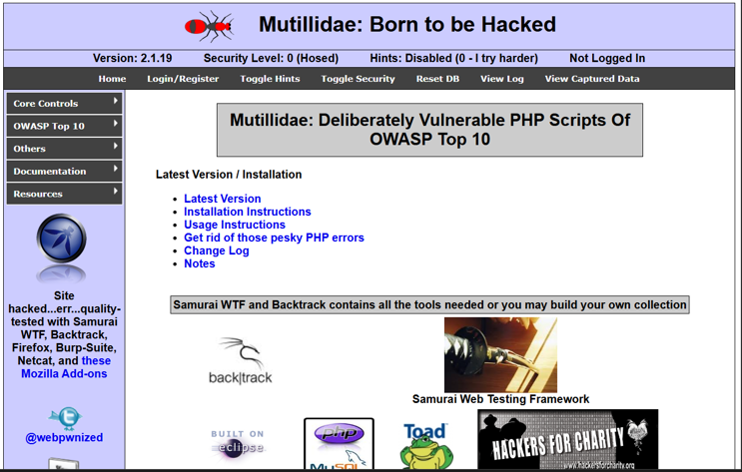

Slide 12
Result
All project objectives were completed successfully.
Metasploitable is running properly, user creation is verified, snapshot is taken, and Mutillidae II works without any database error.

